Slide 1
HEART RATE MEASUREMENT FROM FACIAL VIDEO
GUIDE:
DR.L. SAIRAMESH
Bhuvaneshwari P,
2019202008,
MCA-Regular.

Slide 2
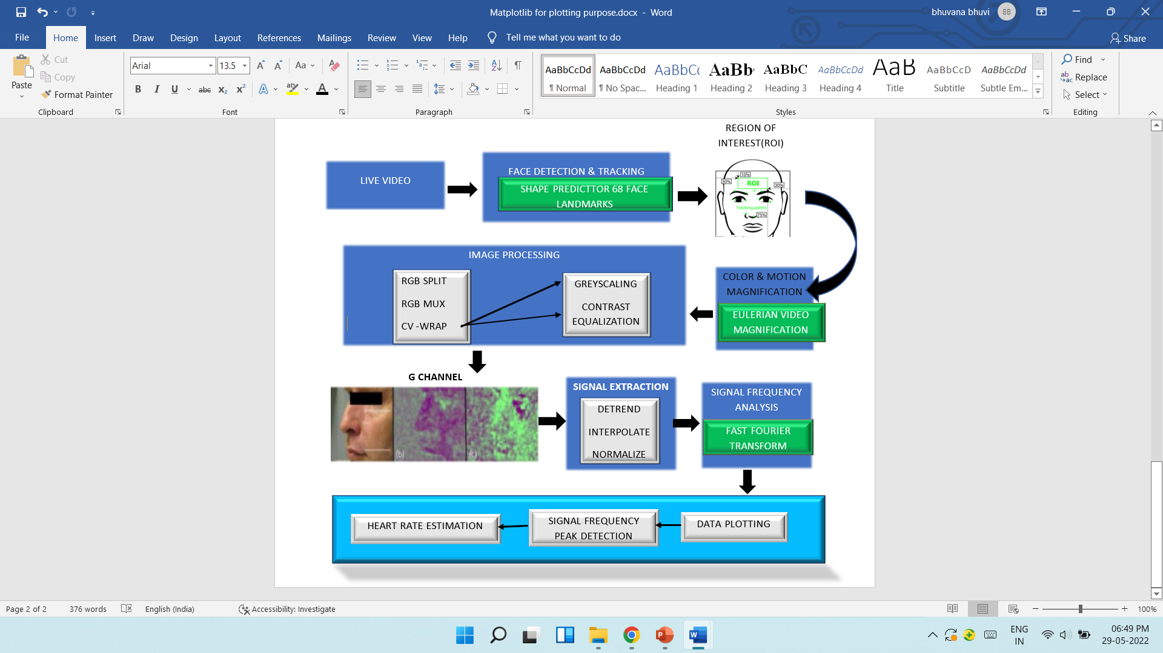
OVERALL ARCHITECTURE

Slide 3
LIST OF MODULES
Video capture
Facial landmarks detection and tracking
ROI detection and tracking
Frame conversion
Eulerian video magnification
Image processing
Signal processing
Data plotting
Heart Rate Measurement

Slide 4
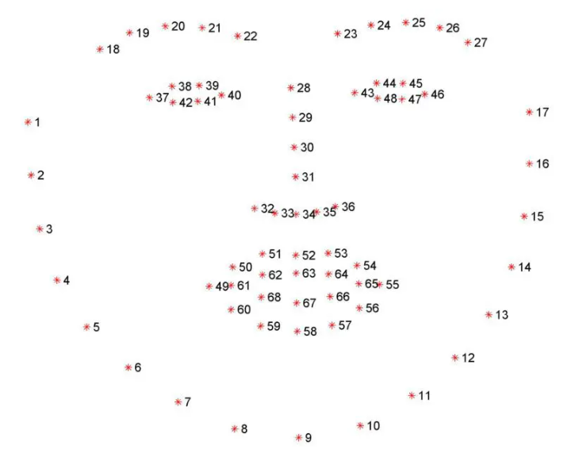
SHAPE PREDICTOR FACIAL LANDMARKS
Facial landmarks are used to localize and represent salient regions of the face, such as:
Eyes
Eyebrows
Nose
Mouth
Jawline
Facial landmarks have been successfully applied to face alignment, head pose estimation, face swapping, blink detection and much more.

Slide 5
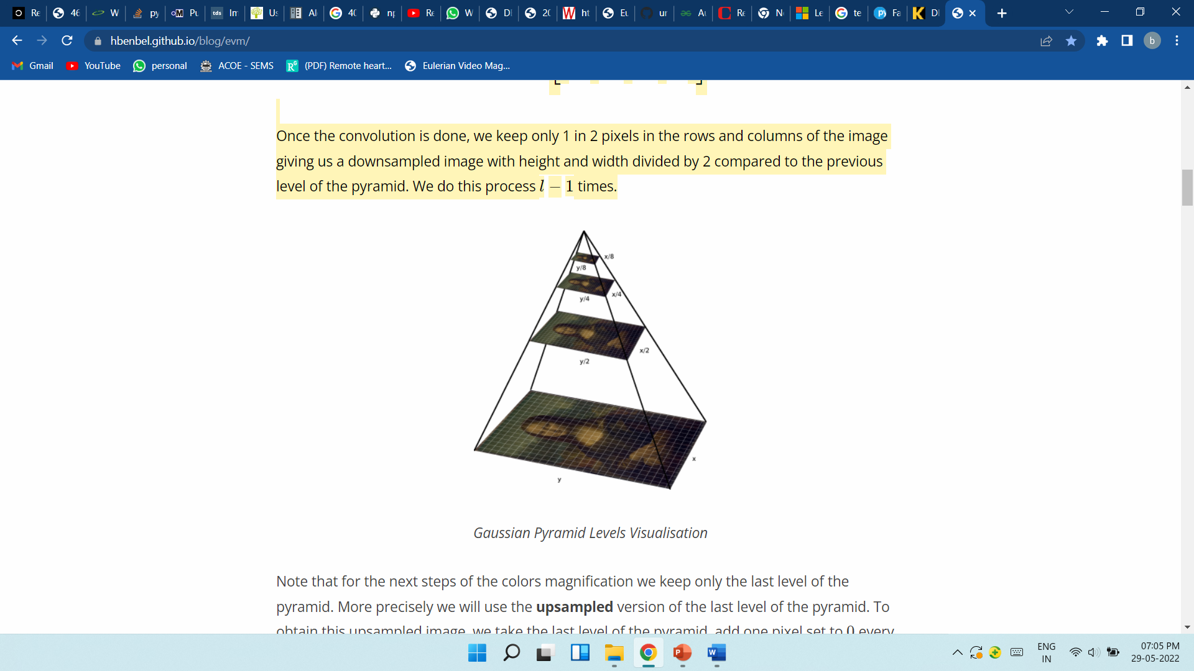
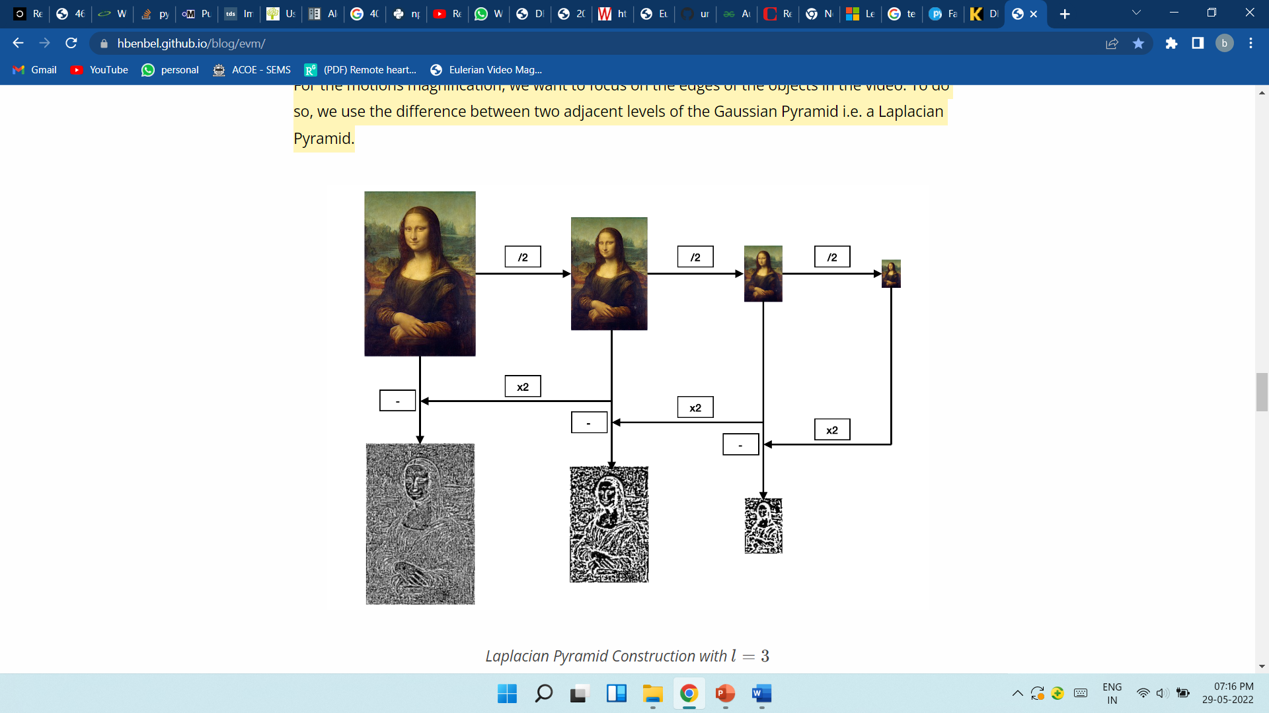
EULERIAN VIDEO MAGNIFICATION
COLOR MAGNIFICATION
GAUSSIAN PYRAMID
MOTION MAGNIFICATION
LAPLACIAN PYRAMID

Slide 6
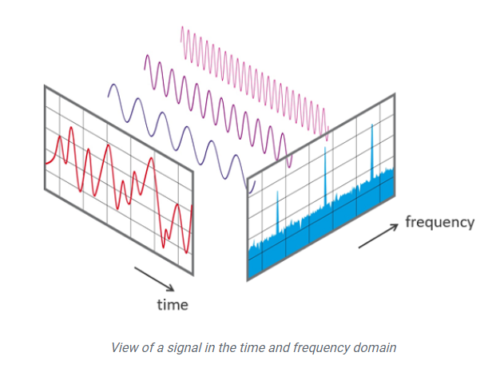
FAST FOURIER TRANSFORM
The component signals were fast Fourier transformed.
An FFT converts the component signals into an estimation of power spectra (squared magnitude) .
A high peak in power at a certain frequency means that the component was made up mostly of a sine-wave at that specific frequency.
This frequency is in most cases a reflection of the detected heart rate.

Slide 7
MODULES IMPLEMENTATION (80%)
Camera: Get the live video from user and covert the video into frames.
Input: captured video, output: frames.
Image Processing: Whole-frame image processing components & helper methods
RGB split: Extract the red, green, and blue channels from an (n,m,3) shaped array representing a single image frame with RGB color coding.
RGB mux: Take three (m,n) matrices of equal size and combine them into a single RGB-coded color frame.
CV wrap: Generic wrapper to take the simpler functions from the cv2 or SciPy image libraries to generate connectable openMDAO components for image processing.

Slide 8
_
Gray scale: Turn (m,n,3) shaped RGB image frame to a (m,n) frame. Discards color information to produce simple image matrix.
Equalise contrast: Automatic contrast correction for grayscale images.
Face Detection: Defect the face with haar cascade Algorithm.
ROI Detection: Defect the sub region in the face.
Signal Analysis: signal Frequency analysis with Fast Fourier Transform(FFT)
Data plotting: plot the obtained bpm in power spectral density and raw signal.
BPM plot: the estimated heart rate plotted in frame.

Slide 9
SIGNAL PROCESSING
Process within data buffer size
Calculate true fps for interpolation
Spectral leakage
FFT
Pruned FFT
Heart rate estimation

Slide 10
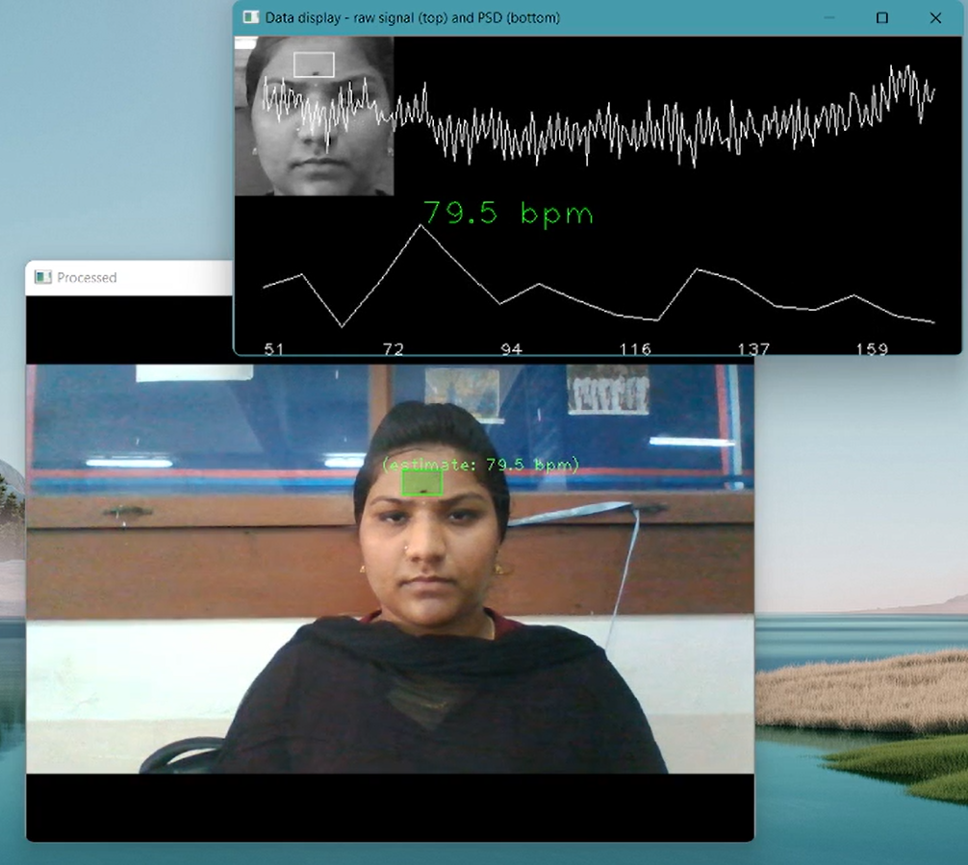
OUTPUT SCREENSHOT

Slide 11
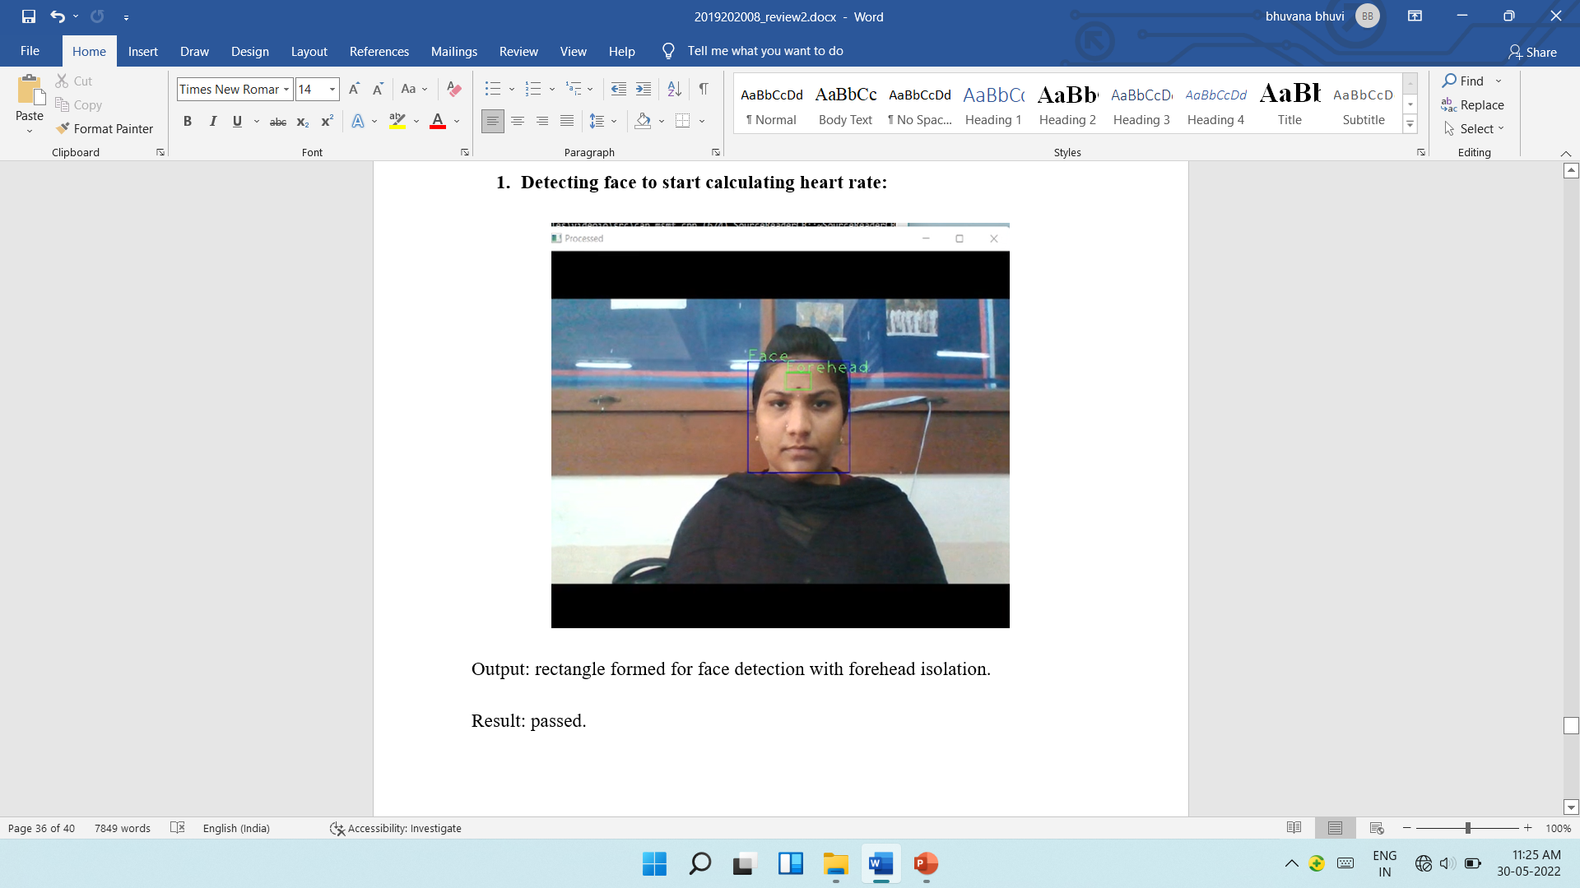
UNIT TESTING WITH TEST CASES FOR EACH MODULE

Slide 12
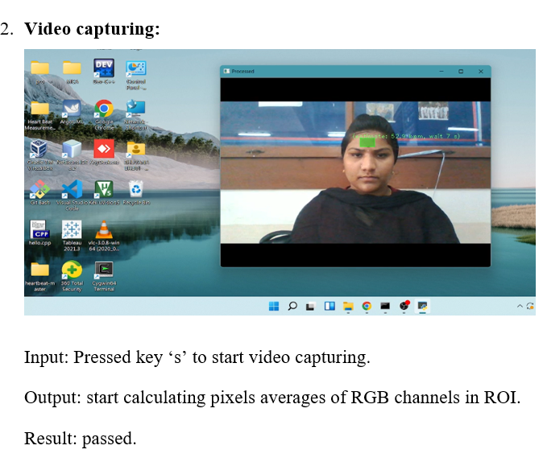
-

Slide 13
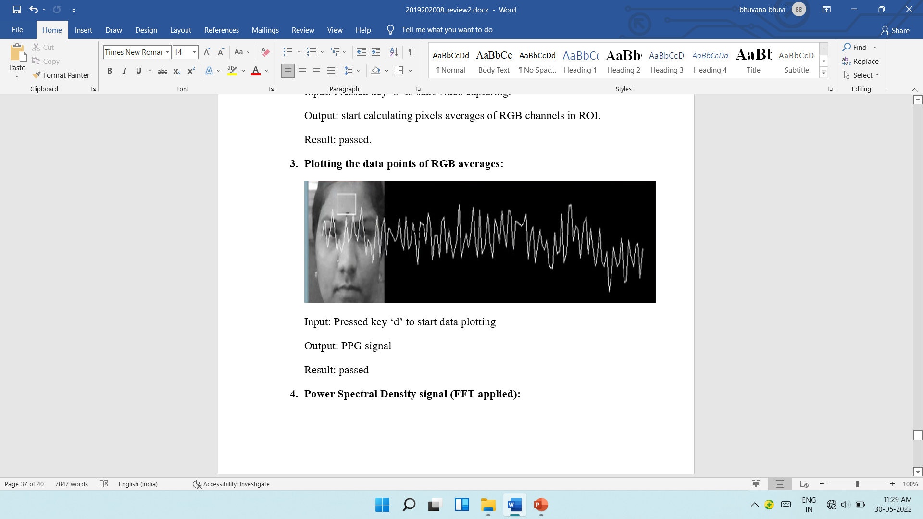
_

Slide 14
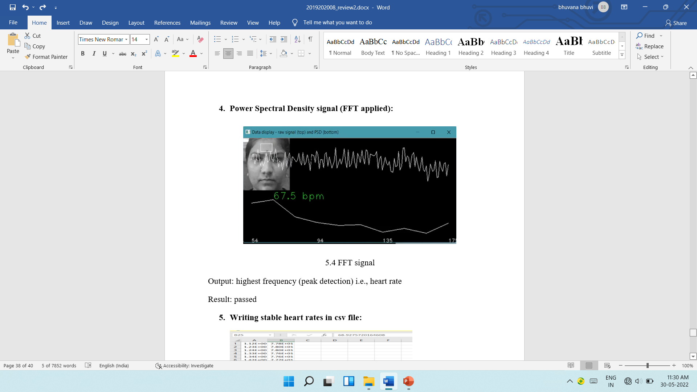
_

Slide 15



